Slide 1



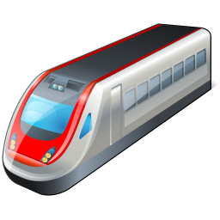
Case 1: Cached content
NRS @ Train
Returns IO
(Address: Support user)
Request URL
Request BO
Return BO
Main User
Support User
Commuter Train

Slide 2
Case 2: Pre-fetched content that has not been shared
NRS @ Train
Returns BO
Request URL
Main User
Support User
Commuter Train

Slide 3
Case 3: New Content
NRS @ Train
Returns Not Found
Request URL
Main User
Support User
Commuter Train

Slide 4

Case 3.1: New Content – Fetch data
NRS @ Train
Retrieve Content
Main User
Support User
Commuter Train

Slide 5
Case 3.2: New Content – Publish
NRS @ Train
Publish content
Main User
Support User
Commuter Train

